Slide 1
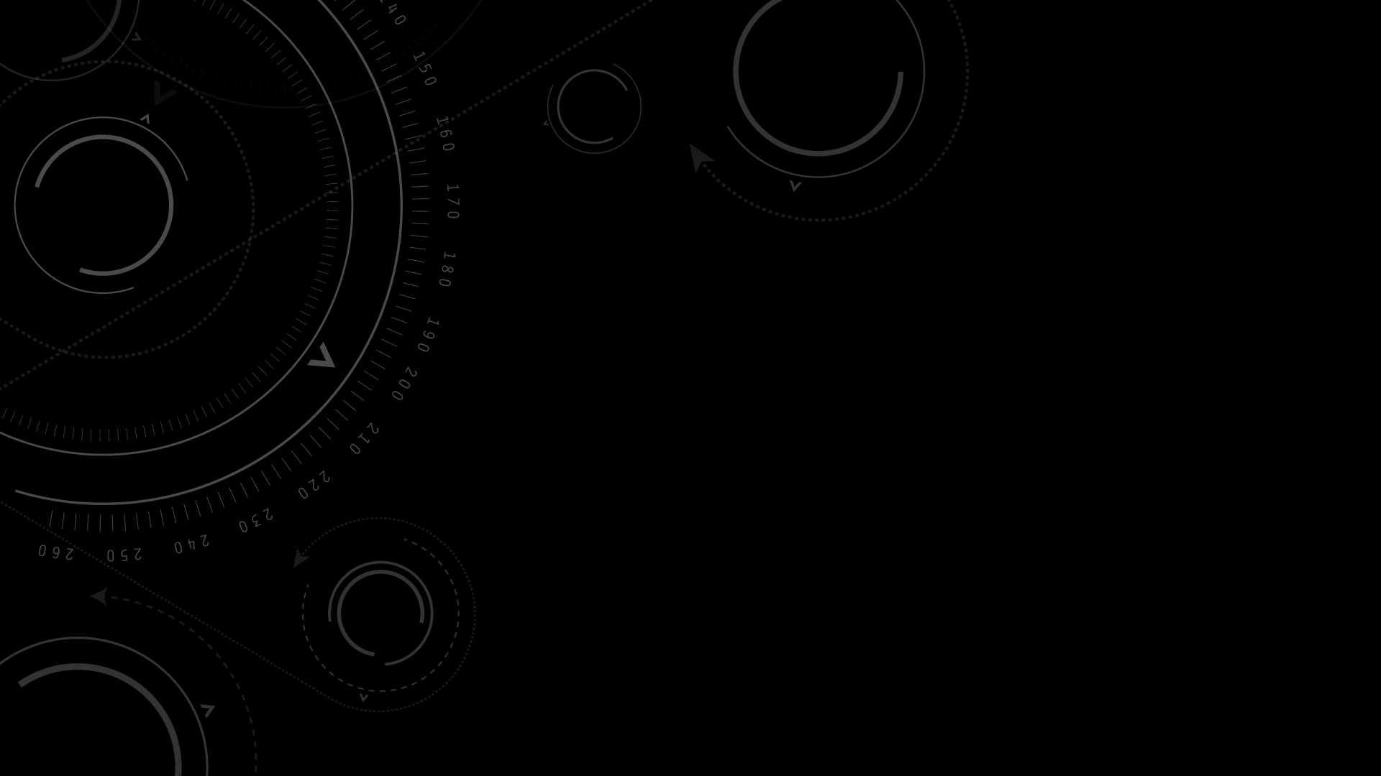
Artificial Neural Networks
Shane Kimble

Slide 2

Artificial Neural Network (ANN) - Introduction
Model BASED ON structure and functions of biological neural networks
Introduced in 1943 by Warren McCulloch and Walter Pitts
Are capable of supervised (Classification, Regression), unsupervised (Clustering/SOM), and reinforcement learning (Environmental Reward-Punish)
Copious amounts of linear algebra and calculus

Slide 3
Common Misconceptions
Artificial Neural Networks (ANNs) (Currently)
Are NOT the end-all-be-all of Artificial Intelligence
Are NOWHERE close to general human intelligence
Do NOT mimic biological human brains
Do NOT lead to Artificial Sentience
The media makes ANNs appear far scarier than they actually are (technically and ethically)

Slide 4
Classification/Regression
Are we predicting a continuous number? Regression
Ex: Amount of calories
Are we predicted a categorical label? Classification
Ex: Healthy or Unhealthy
Both are sometimes applicable to the same problem
Ex: If over `A` calories and less than `B` amount of exercise, Unhealthy. Else, Healthy

Slide 5
Clustering
Grouping data with similar features and assigning labels. Meaningful labels are often assigned by the people interpreting the clusters

Slide 6
Reinforcement Learning
Reward/Punishment system

Slide 7
Deep Learning
Most Deep Learning Models are Based on Artificial Neural Networks

Slide 8
We’ll Cover only the First two 🤯

Slide 9
Single Layer Perceptron

Slide 10
Single Layer Perceptron
The simplest ANN
Feedforward – Push a sample straight through, predict, and learn from the miss amount
Example: classification of an object given height and width, as a bed, table, or chair

Slide 11
1. Map INPUT and Output variables

Slide 12
2. Initialize Synapses as random values

Slide 13
3. Forward Propagation
f(x)
Define Activation Function For Output
For each output node, activate given certain a condition.
Common examples include an all-or-nothing threshold, or always activate and produce continuous output

Slide 14
4. Forward Propagation
Get the Dot Product (Matrix Multiplication) of The Inputs and the Weights

Slide 15
5. Forward Propagation
f(x)
Activate the Output Neurons following multiplication of inputs and weights. The activated neurons are the output

Slide 16
6. Backpropagation
Predicted
How off was the predicted output?
Actual

Slide 17
Backpropagation
f’(x)
Take the derivative of the activation function. Call it activation function prime

Slide 18
Backpropagation
Predicted
f’(x)
Re-activate the original output neurons with the prime activation function
Delta: Multiply this result by the miss amount
Actual

Slide 19
Backpropagation
Gradient (δMiss δWeights): Multiply the delta by the transpose of the previous layer (chain rule)
Adjust weights using this gradient
Repeat with more data, and predictive ability will increase

Slide 20
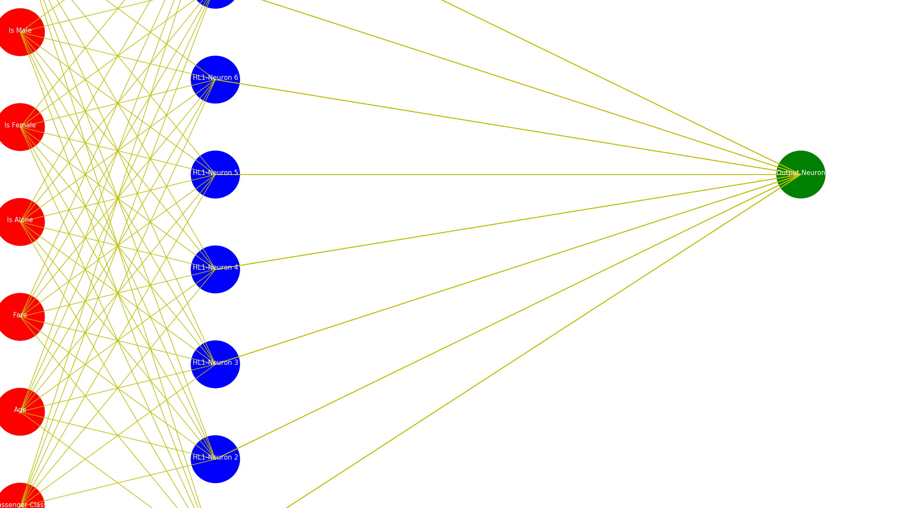
MultiLayER Perceptron

Slide 21
MultiLayer Perceptron
The process is nearly identical to the single layer perceptron ANN
One additional step to be aware of is during backpropagation, generating further deltas requires multiplying three variables:
The previous delta
The previous weights transposed
The previous layer of neurons

Slide 22
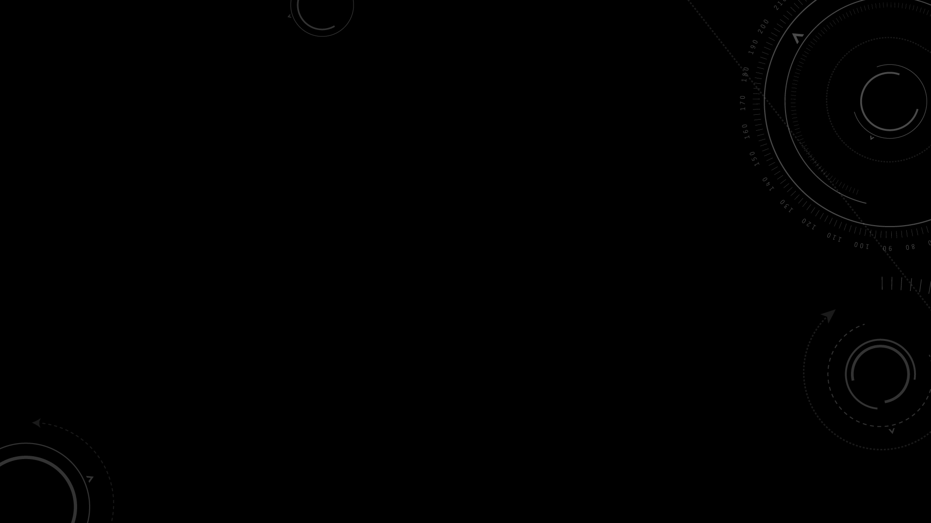
Advantages
Great performance under the right conditions – Can pick up on complex, non-linear relationships
Fault tolerance – Incomplete data or inactivation of neurons doesn’t hinder output generation
Parallel processing – Can perform multiple jobs at the same time
Scalable – Understanding of data can grow with both model and data size
Strong academic activity and ongoing research

Slide 23
Disadvantages
Hard or impossible to interpret once trained (Black Box)
Structuring and tuning is unintuitive, and trial and error is often the only option
Not optimal for small datasets, or datasets that have lots of uncertainty
Often requires more powerful hardware
Prone to overfitting

Slide 24
Should you use it?
No:
If you want to know the most important variables contributing to a model’s predictions, ANNs should be ruled out
The problem of interest is probabilistic and requires a more statistical foundation. Other models will often yield better performance
Yes:
The solution to the given problem is non-algorithmic – often best for problems that people are good at solving
You want the model to learn over time for a single sample, similar to a child. An example is the entire history of an employee working at a company, then leaving – unlike looking at snapshots of time for the given employee
You want the best performance possible, have clean and labeled data, and a large quantity of records

Slide 25
Questions?
Check out my documented implementation of the ANN here:
https://github.com/summonholmes/mlp-pandas

